Slide 1

Stock Market Analysis: A Comparative Study of LSTM, Linear Regression and Random Forest
This presentation compares three machine learning models for stock market prediction: Long Short-Term Memory (LSTM), Linear Regression, and Random Forest. We analyze their performance on a real-world stock dataset, covering preprocessing, model architecture, training, performance metrics, and model evaluation.
by Yuvan Shankar S
23AM125

Slide 2
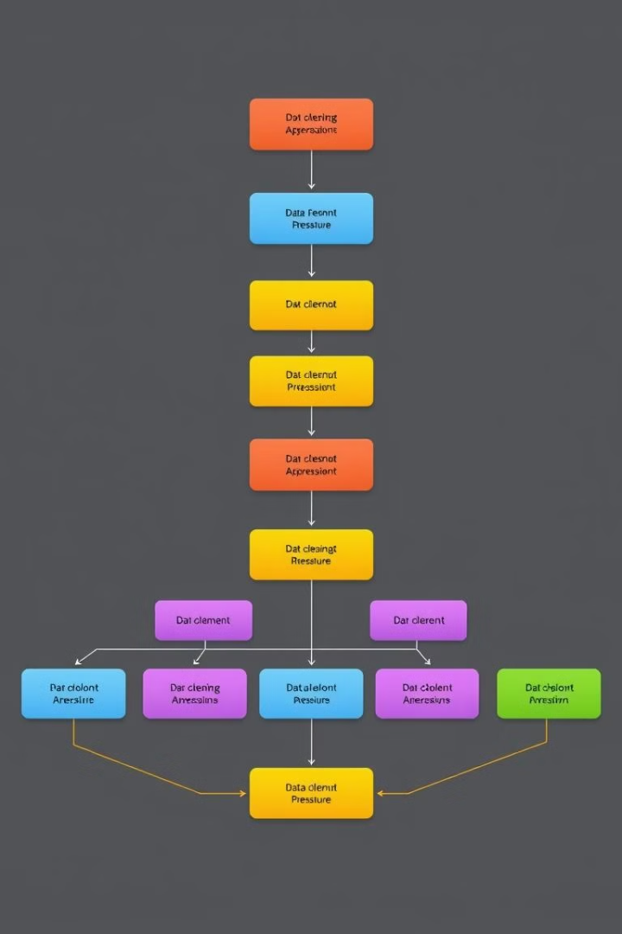
Dataset Preprocessing
1
Missing Data
2
Feature Engineering
Missing values are handled using imputation techniques, such as mean or median imputation, to ensure data completeness for model training.
New features are derived from existing data, such as moving averages and momentum indicators, to improve model accuracy.
3
Normalization
Data is normalized to a consistent range, typically between 0 and 1, to prevent bias towards features with larger scales.

Slide 3
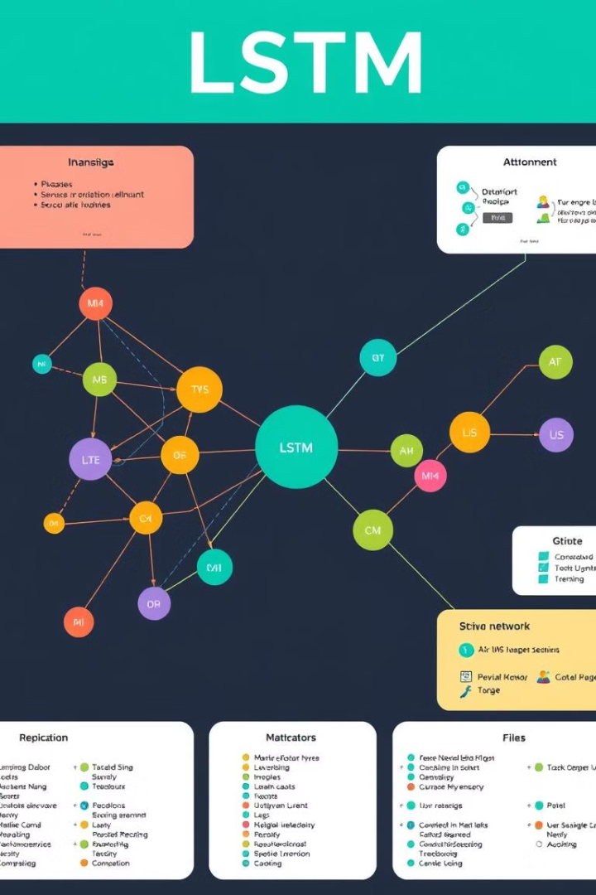
LSTM Model
1
Architecture
The LSTM model consists of multiple layers of recurrent neural network cells, each with memory units to capture temporal dependencies in time series data.
2
Hyperparameters
Parameters such as the number of hidden units, learning rate, and dropout rate are tuned to optimize model performance.
3
Training Process
The model is trained using backpropagation through time, adjusting weights to minimize the difference between predicted and actual stock prices.

Slide 4
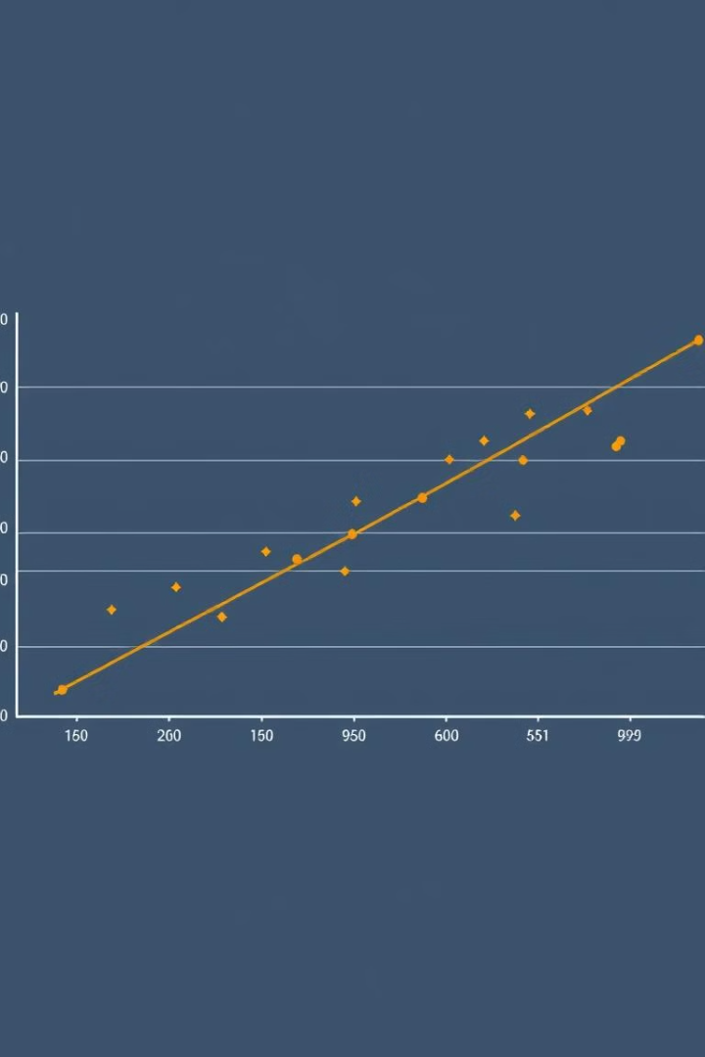
Linear Regression Model
Assumptions
Feature Selection
Training
Linear regression assumes a linear relationship between independent variables and the dependent variable, with normally distributed errors.
The model learns a linear equation that minimizes the sum of squared errors between predicted and actual stock prices.
Relevant features are identified through correlation analysis and feature importance techniques to ensure a strong linear relationship.

Slide 5
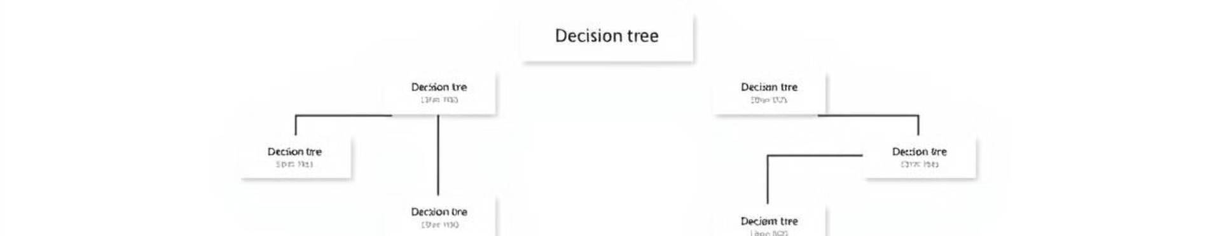
Random Forest Model
Tree-based Structure
Parameter Tuning
Ensemble Learning
The Random Forest model consists of multiple decision trees, each trained on a random subset of data and features.
Parameters such as the number of trees, maximum depth, and minimum samples per leaf are adjusted for optimal performance.
Predictions from individual trees are averaged to reduce variance and improve overall model accuracy.

Slide 6

Performance Metrics
Metric
Description
Accuracy
The accuracy of the model represents the percentage of correctly predicted stock price movements.
R-squared
R-squared is a measure of how well the model explains the variation in stock prices. A higher R-squared value indicates a better fit, suggesting that the model is more effective at capturing the relationship between the independent variables and the dependent variable.

Slide 7
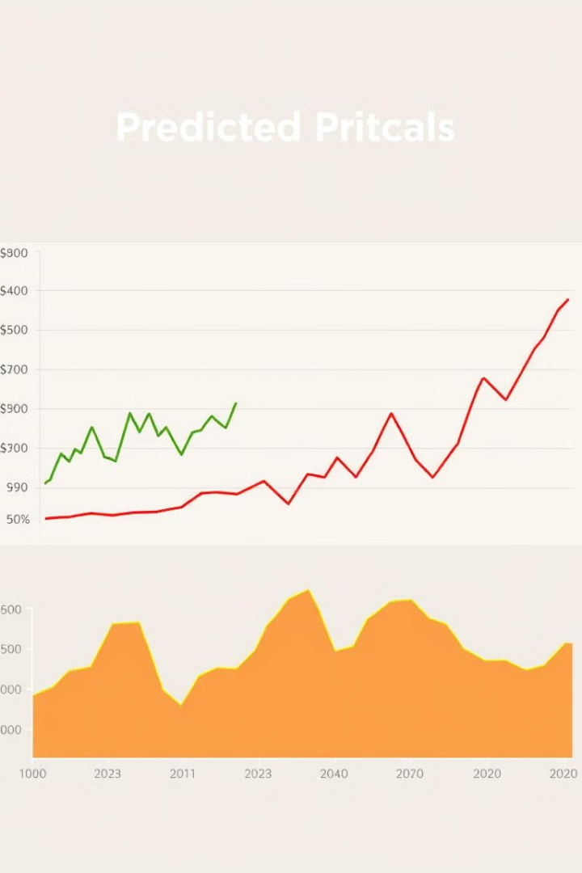


Visualizations
Actual Stock Prices
The actual stock prices are plotted as a time series, representing the historical data used for training and evaluation.
Predicted Stock Prices
The predictions from each model are plotted alongside the actual prices to visually assess model accuracy and performance.

Slide 8
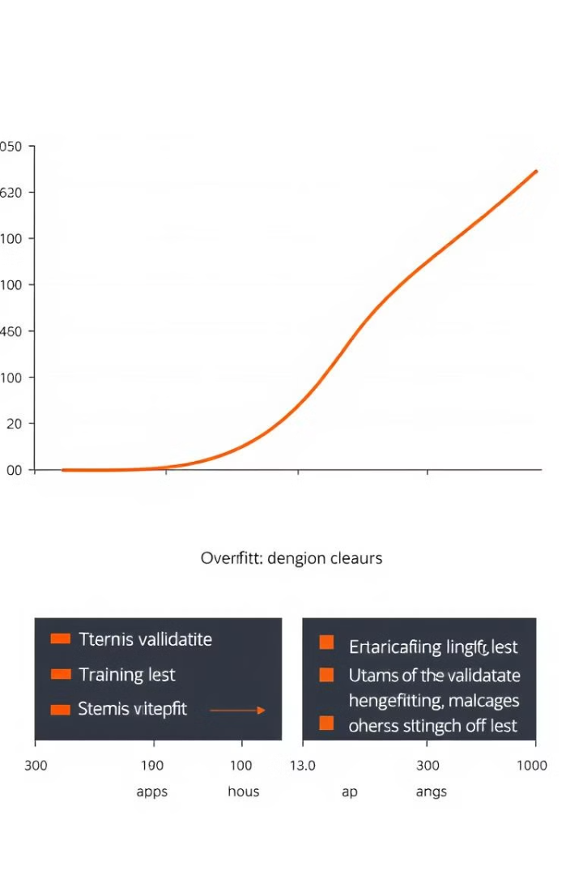



Insights and Discussion
Overfitting
Models may overfit the training data, leading to poor generalization and prediction accuracy on unseen data.
Underfitting
Models may underfit the data, failing to capture underlying patterns and resulting in low accuracy.
Prediction Stability
Models should exhibit consistent prediction accuracy over time to be considered reliable for stock market forecasting.

Slide 9
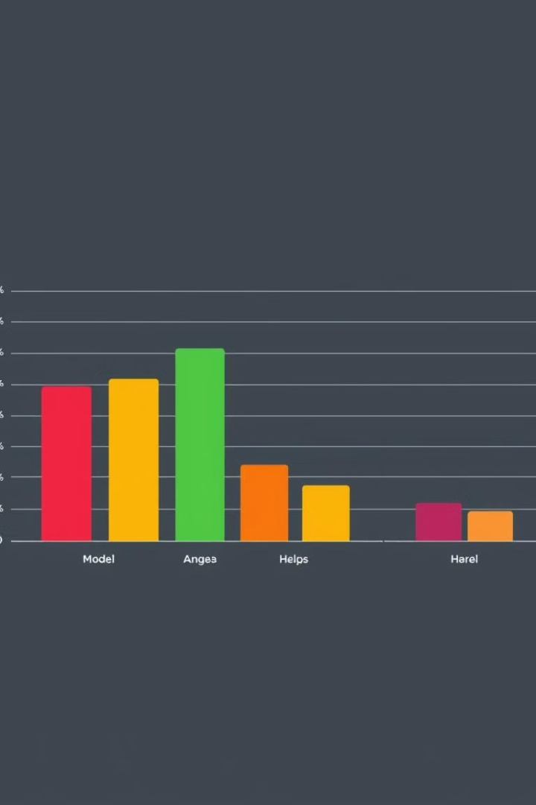
Model Comparison
1
LSTM
2
Linear Regression
Strong in capturing temporal dependencies, but can be prone to overfitting and computationally expensive.
Simple and interpretable, but may struggle with non-linear relationships and require careful feature engineering.
3
Random Forest
Versatile and robust, but may be less accurate for complex time series patterns.

Slide 10
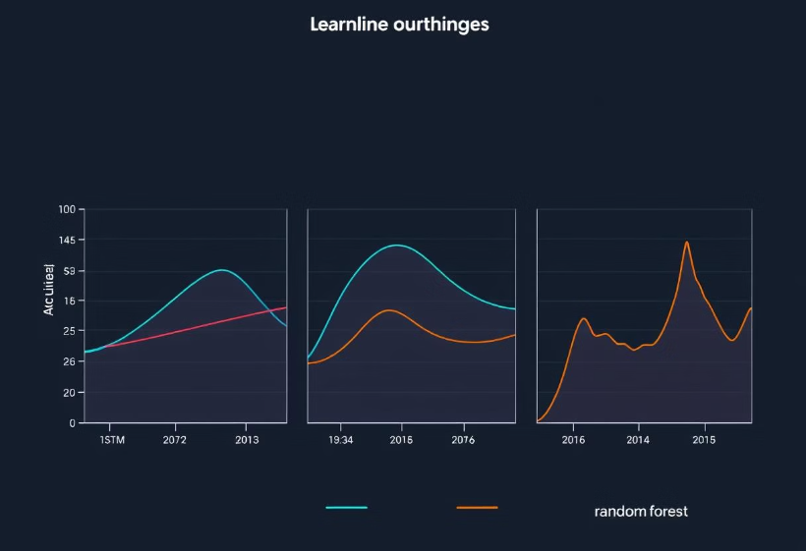
Conclusion
Model Selection
The choice of model depends on specific requirements. LSTM is suitable for complex time series, linear regression for simple relationships, and Random Forest for a balance between accuracy and robustness.

